Slide 1

Opinion dynamics models in empirically justified networks
Joel Wildman (22984156)

Slide 2
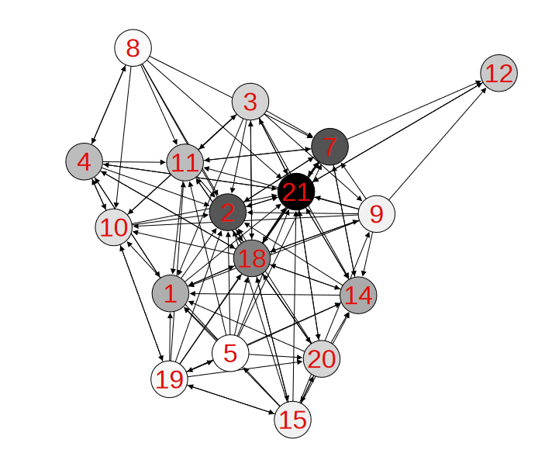
An introduction to social modelling
What are Social Networks?
What are Opinion Dynamics Models?
How can we improve them?
Problem statement
Reduced Krackhardt’s advice network
with 17 nodes, Jia, P., MirTabatabaei, A., Friedkin, N. E., & Bullo, F. (2015). Opinion dynamics and the evolution of social power in influence networks. SIAM review, 57(3), 367-397.
Notes:
1934 Who shall survive?: A new approach to the problem of human interrelations
Improvement: plausibility and other factors
Many studies but no uniform progress, just new content (wide body of research, but not particularly deep)
Problem statement:
can we improve our understanding of ODM function by altering network topology
specifically, if we use real, empirically justified topologies, can this inform us about how plausible these models are

Slide 3
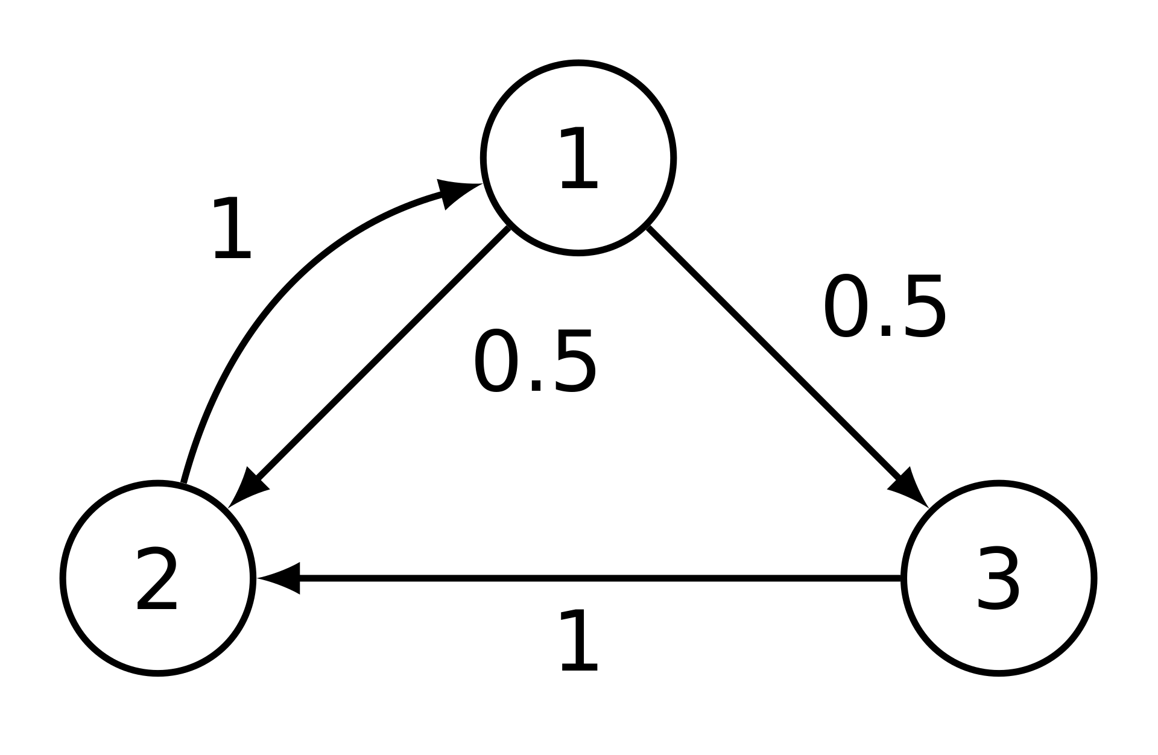
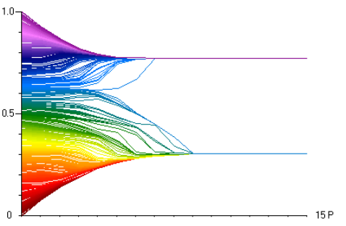
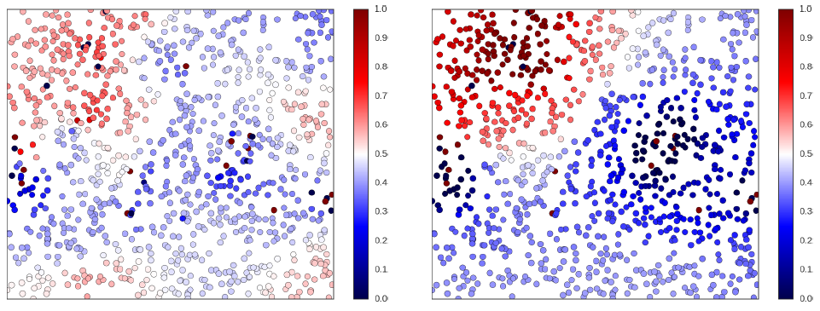
Existing Models
Older Models
Mathematically oriented
Advent of computer simulation
Modern models
Example of convergent network in the DeGroot Model
Hegselmann-Krause bounded confidence model
Rainer, H., & Krause, U. (2002). Opinion dynamics and bounded confidence: models, analysis and simulation.
Peter Duggins’ social influence model environment
Duggins, P. (2014). A psychologically-motivated model of opinion change with applications to American politics. arXiv preprint arXiv:1406.7770.
Notes:
Old models:
well defined by mathematical functions
reaching a consensus (1974)
often exhibited simple behaviour
homogenous agents
linear functions
Characteristics of real opinions:
(a) diversity of opinions across society, (b) opinion subcultures, and (c) pluralistic ignoranc
New models:
driven by simulation
heterogeneous models and persistently complex behaviour

Slide 4
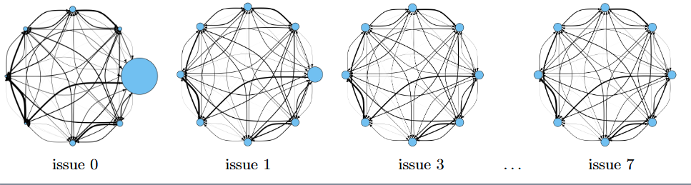
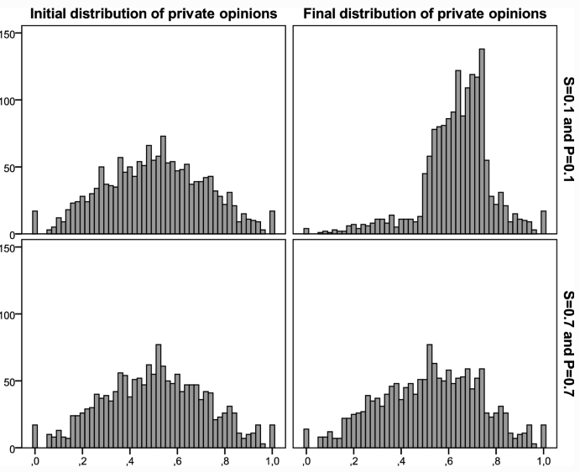
Which are right for us?
DeGroot-Friedkin model
Mathematical basis
Preference Falsification Simulation model
Psychologically driven, complex system
Jia, P., MirTabatabaei, A., Friedkin, N. E., & Bullo, F. (2015). Opinion dynamics and the evolution of social power in influence networks. SIAM review, 57(3), 367-397.
VS
León-Medina, F. J., Tena-Sánchez, J., & Miguel, F. J. (2020). Fakers becoming believers: how opinion dynamics are shaped by preference falsification, impression management and coherence heuristics. Quality & Quantity, 54(2), 385-412.
Notes:
Benchmark/baseline
Each of the rules are justified by a numberof psychology or sociology studies, not strictly mathematical/computer science based

Slide 5
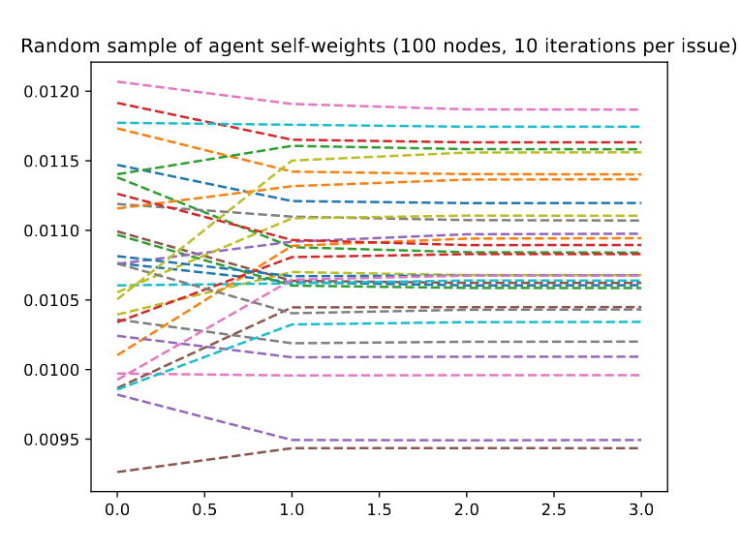
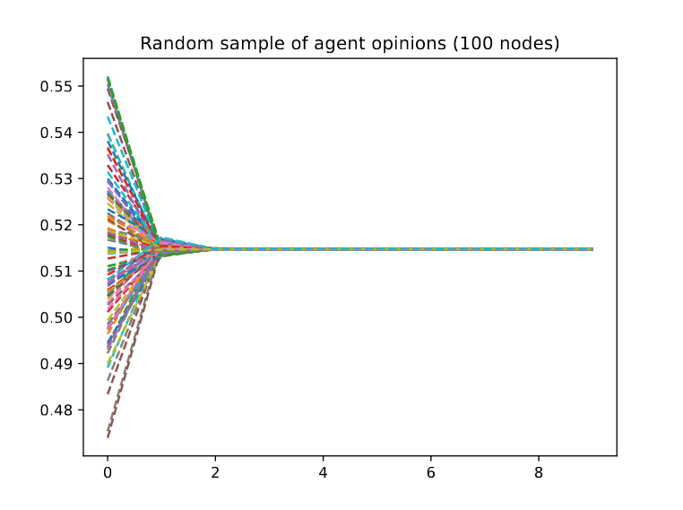
DeGroot-Friedkin model
General principle
Update rules
Environment
Issue
Opinion
DGF self weights over 10 issues, 100 node complete graph
Iteration
DGF opinions over 10 issues, 100 node complete graph
Notes:
Principle:
combination of degroot model (Reaching a consensus) (1974) and A Formal Theory of Reflected Appraisals in the Evolution of Power (2011) Noah Friedkin
Rules:
adopt the weighted average of your neighbours
adjust your self confidence as a function of how much influence you had on the previous discussion
real life equivalent: a cabinet meeting on a series of issues
Environemnt:
directed, weighted graph
weights are arbitrary usually

Slide 6
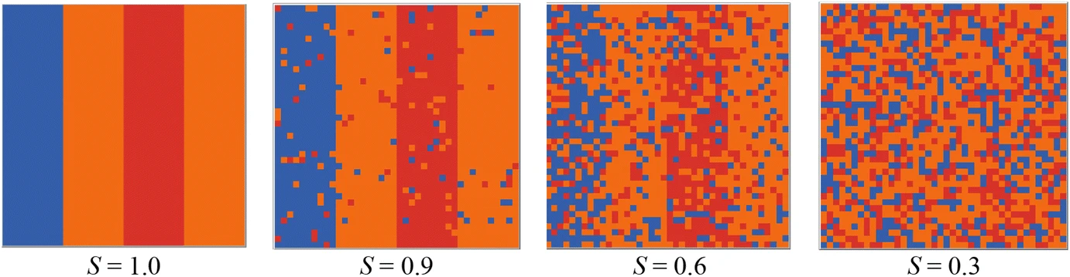
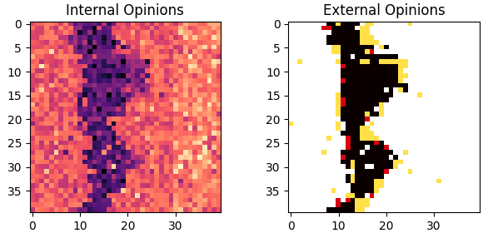
Preference Falsification Simulation model
Guiding principles
Update rules
Environment
Class distribution across segregation levels.
Internal and External opinion distributions after 30 iterations
Notes:
Principles:
guided by observed psychological phenomena
cognitive dissonance
social pressure
Rules:
coherence heuristic
Goffman heuristic
reference opinion guides fakes
Environment:
grid
neighbourhood system
class system

Slide 7
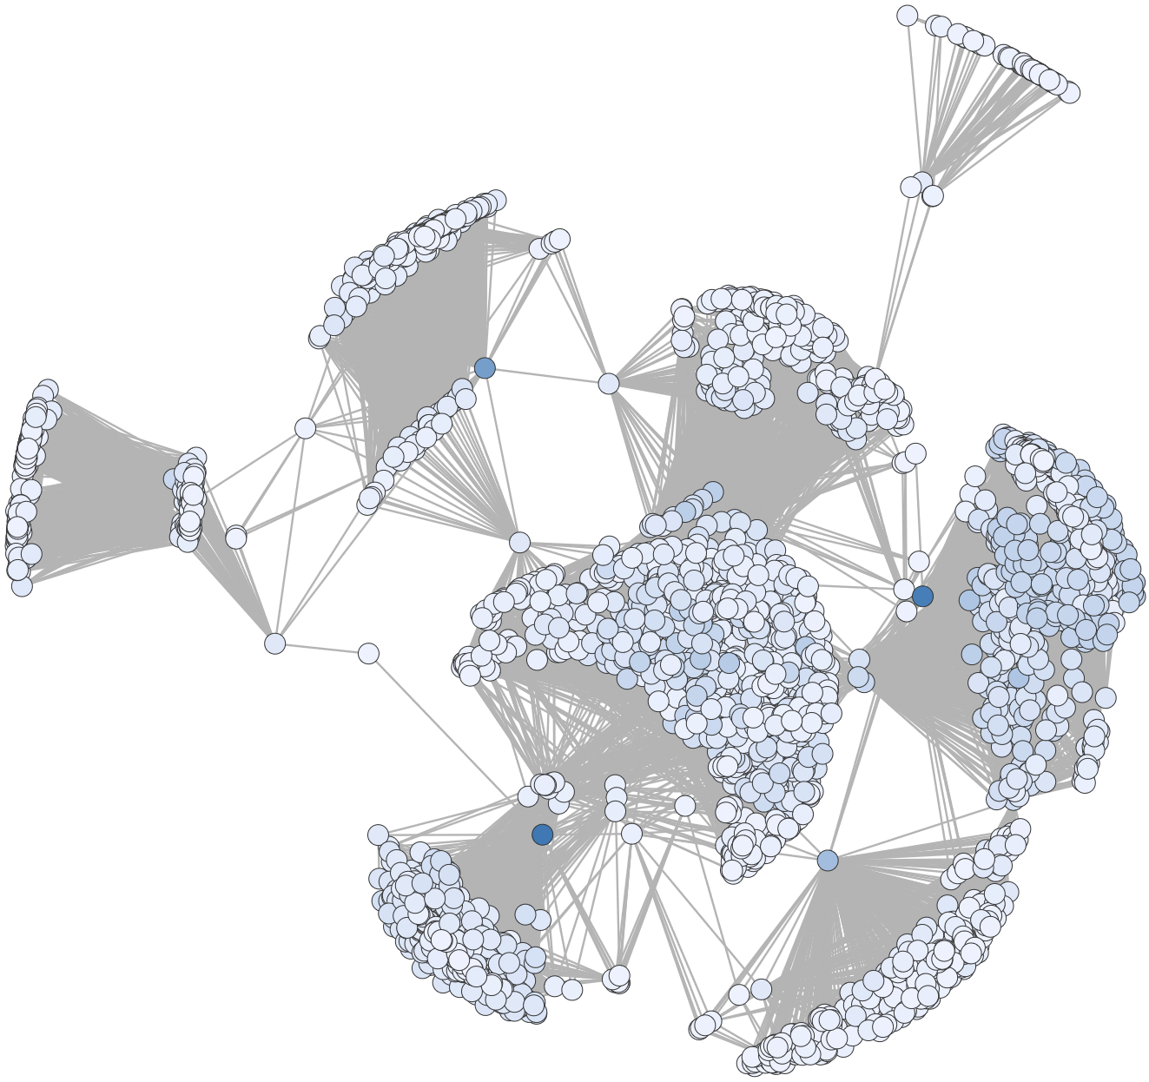
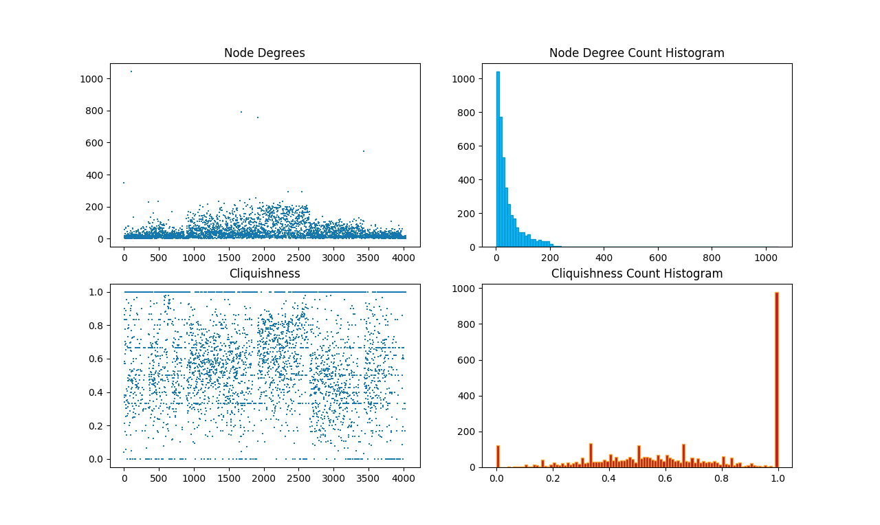
The Facebook Dataset
SNAP origins
Network details & characteristics
Why does this represent an actual social network?
Why is it good for us?
Notes:
Stanford network analysis project
Cliquishness: define
Degree: ~44, stdev of 25, median of 52

Slide 8
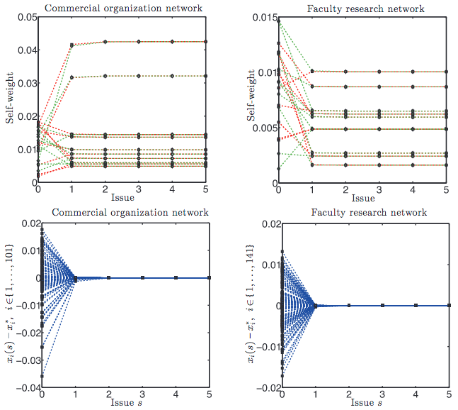
Modifications to the Models
DGF on complete directed graphs
Undirected Facebook graph
Arbitrary weights (discussed later)
Agent self-weight in networks with 101 and 141 nodes respectively. The bottom figures show the error between the self-weight trajectory and equilibrium value.
Jia, P., MirTabatabaei, A., Friedkin, N. E., & Bullo, F. (2015). Opinion dynamics and the evolution of social power in influence networks. SIAM review, 57(3), 367-397.
Notes:
Arbitrary weights are the interpersonal weights we generate
Ultimately minimal changes to model

Slide 9
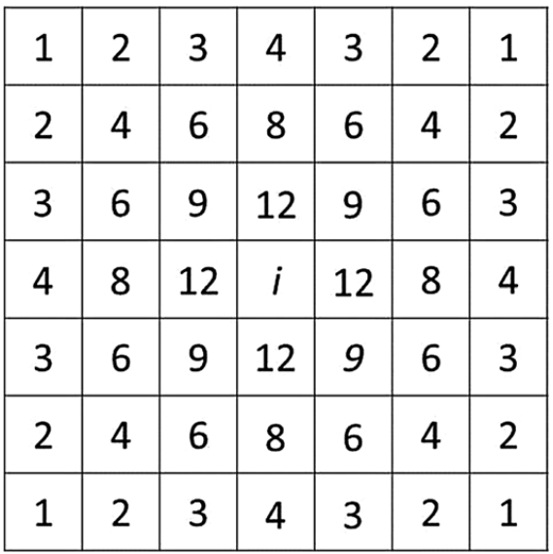
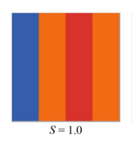
Modifications to the Models
PFS environment incompatibility
Grids as an 8-regular graph
Neighbourhoods with DFS
Number of possible neighbourhoods shared with agent i
Fully segregated agents in grid format
Notes:
Rather significant changes to how the model functions
Max size is 25 with dfs 4, average size is 12
Increasing or decreasing dfs actually results in smaller neighbourhoods
Hopefully equivalent in p erformance

Slide 10
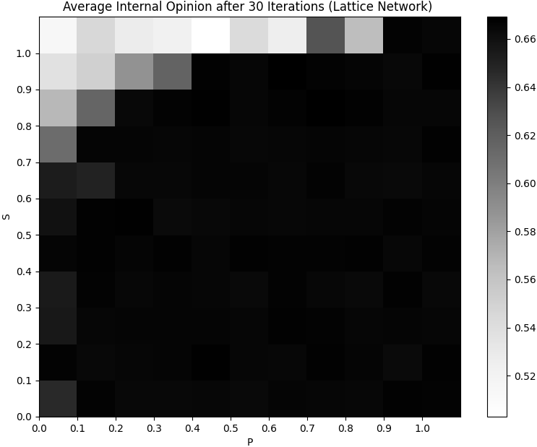
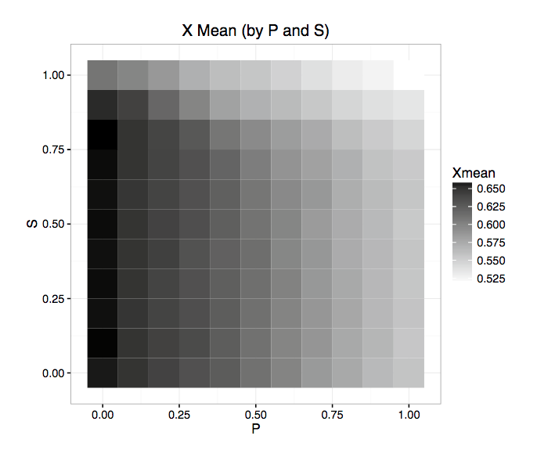
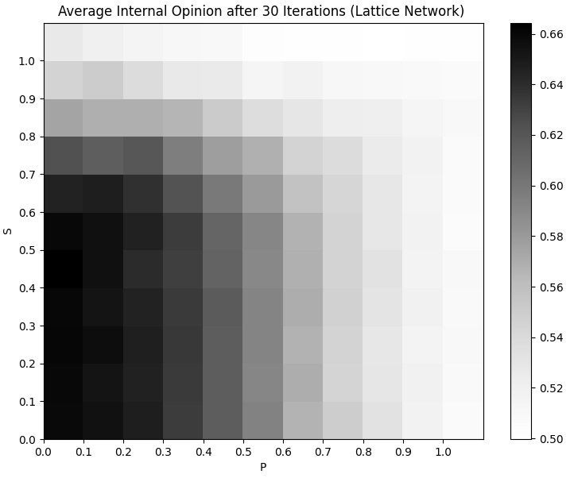
Modifications to the Models
Internal vs External opinions for agent ro_{i}
Model outcomes when global opinion contributes to ro_{i}
?
Model outcomes from paper
Model outcomes when internal opinion contributes to ro_{i}
Notes:
Explain PFS justification for both outcomes
High P = more global influence
LOW P = more local influence

Slide 11
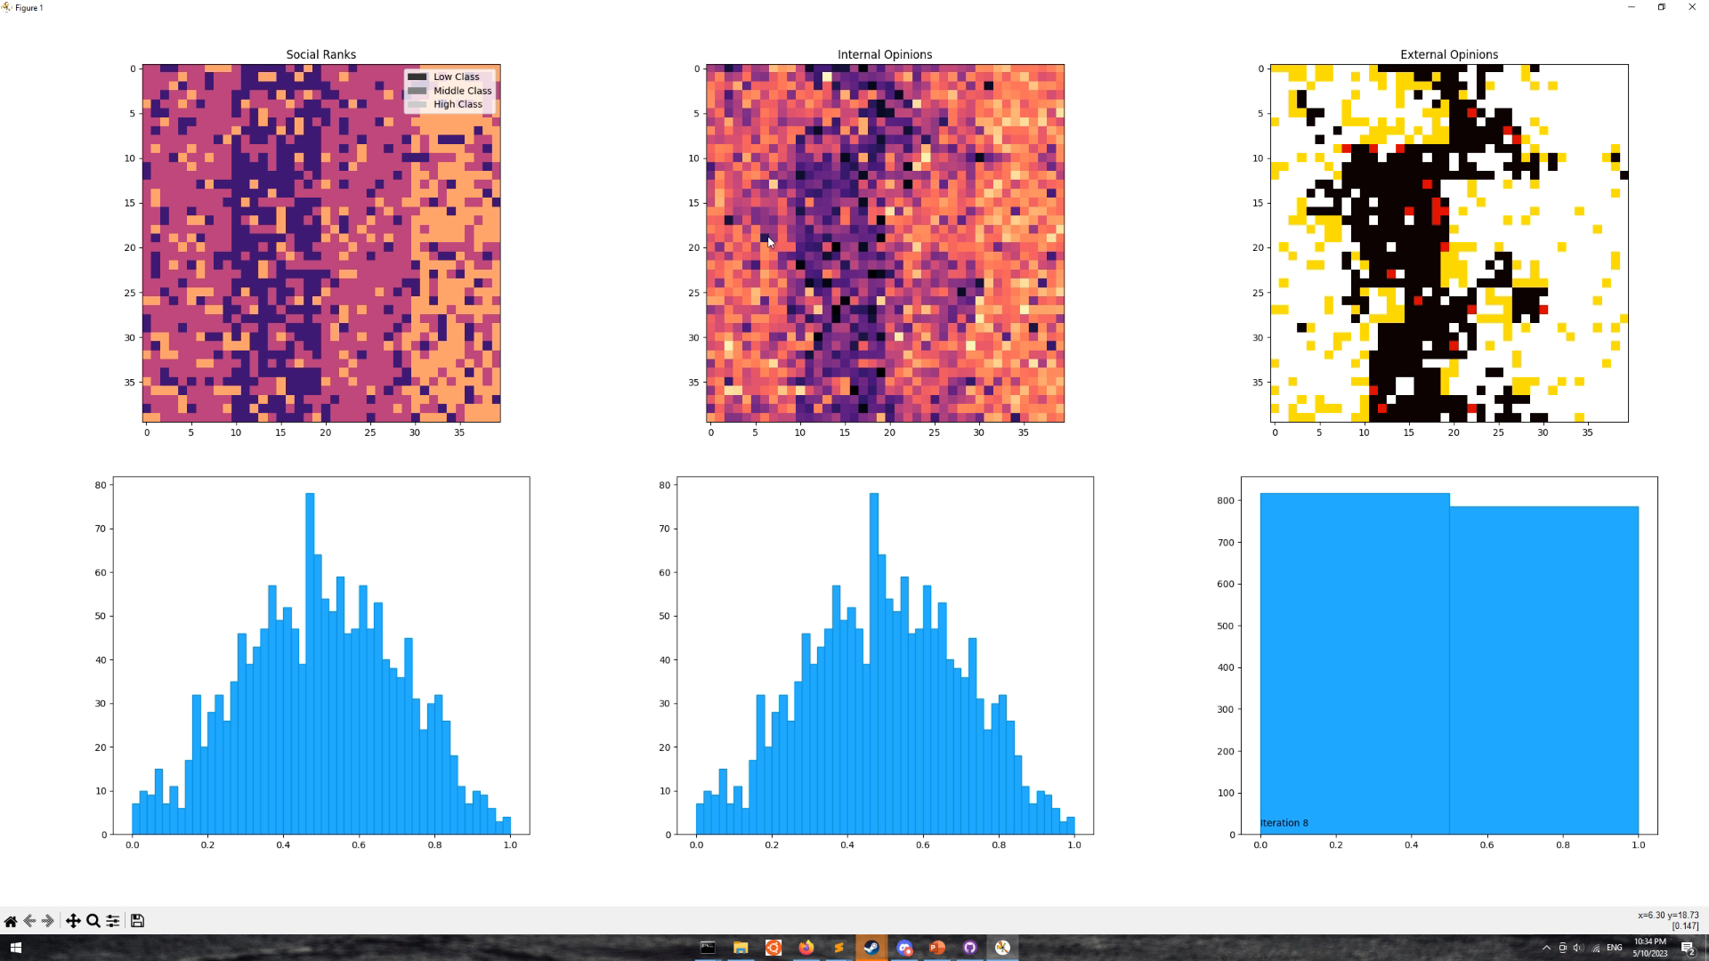
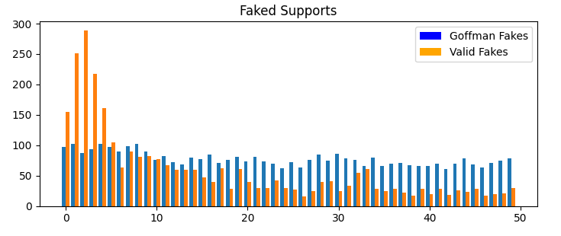
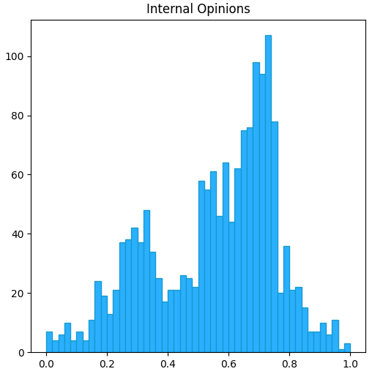
Simulation
Replicating original study
Iteration counts and hardware constraints
Notes:
Behaviour?
real vs protected falsifications
small cliques of self-perpetuating opinions
this is what allows for continued variety in opinion, despite simulation rules being biased towards high opinion

Slide 12
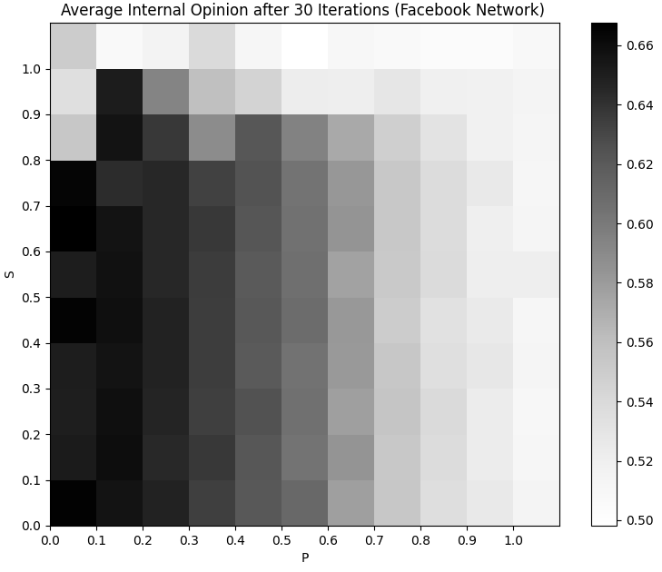
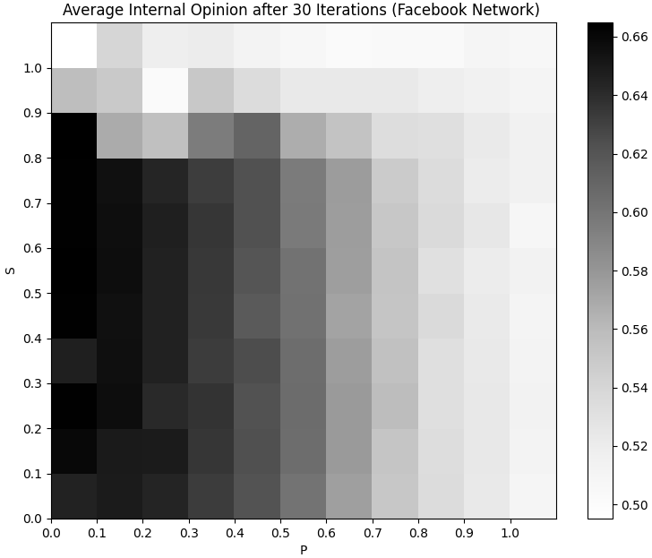
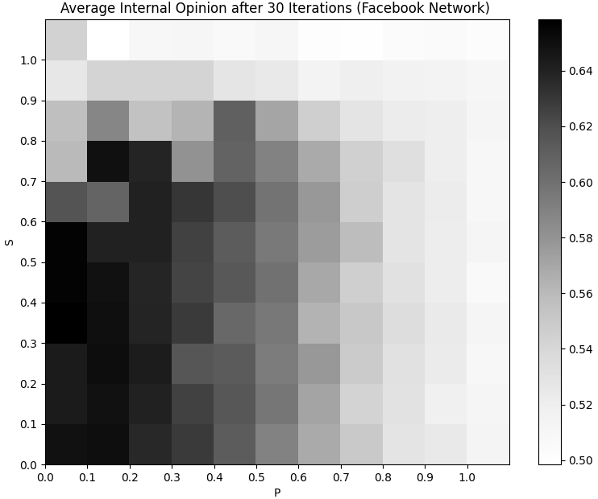
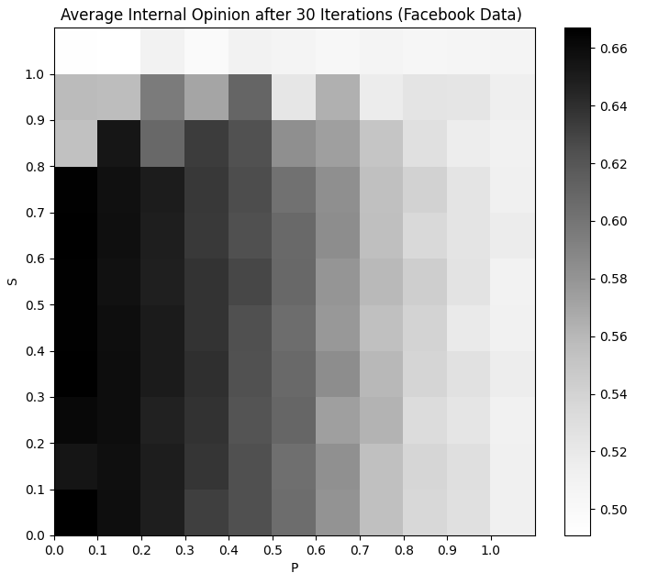
PFS Results
Lattice
70% of edges
(x̄ degree: 30)
50% of edges
(x̄ degree: 21)
30% of edges
(x̄ degree: 13)
Facebook
Notes:
Note on iteration counts and noise
Bias towards unanimity in facebook, across higher range of S values
Seems to place more emphasis on the P value, which becomes more dominant
Does not produce novel mechanics despite changes in simulation outcome

Slide 13
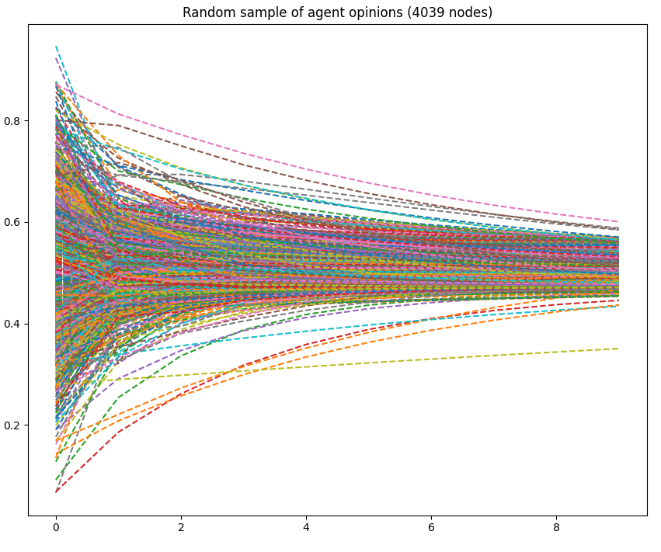
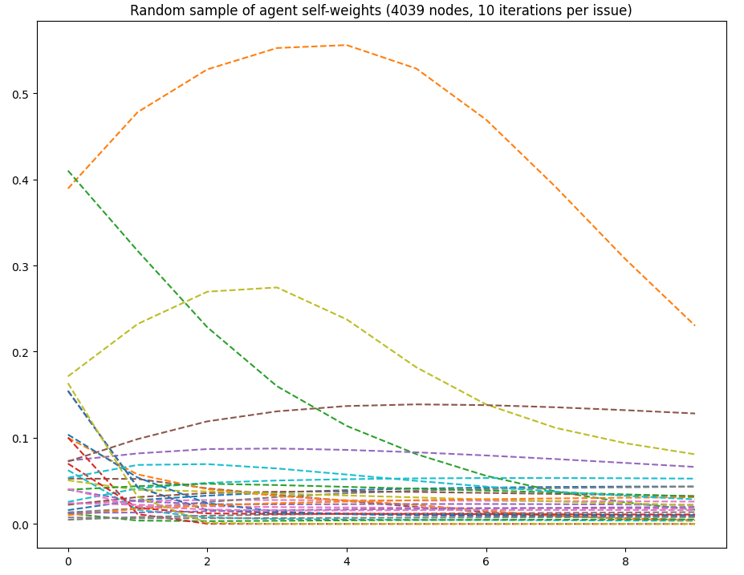
DGF Results
Is this consistent with our understanding?
Possible causes
DGF opinions over 10 issues, 100 node complete graph
DGF opinions over 10 issues, Facebook network
DGF self weights over 10 issues, 100 node complete graph
DGF self weights over 10 issues, Facebook network
Notes:
Note on iteration counts
Less connectivity = less trend towards unanimity/equilibrium points
this matches our understanding
can we examine whether it really is connectivity causing this

Slide 14
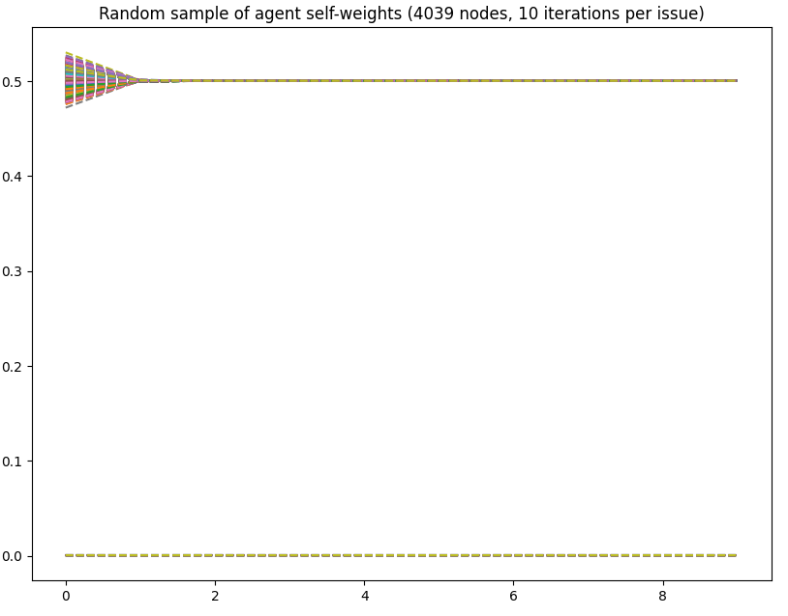
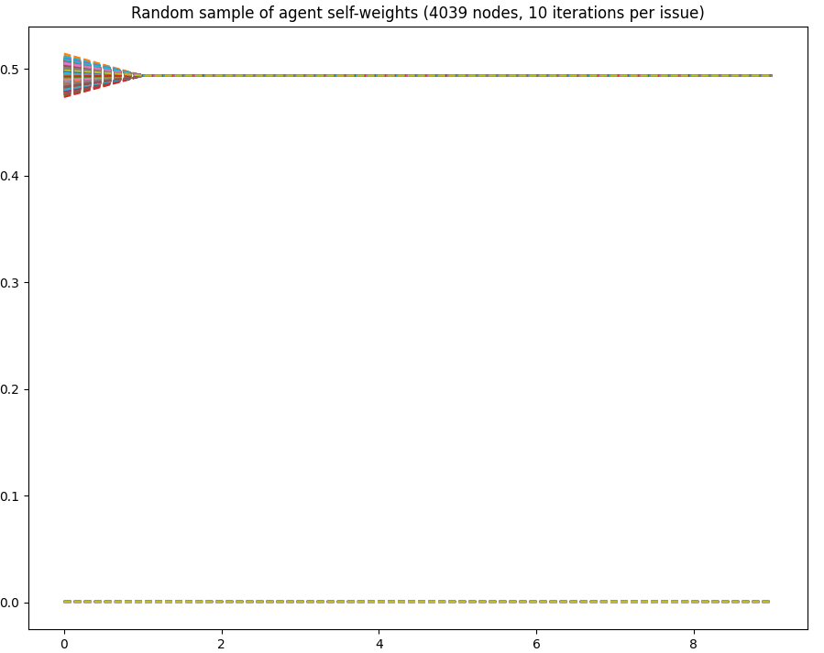
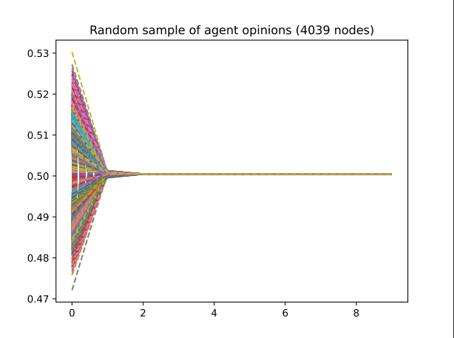
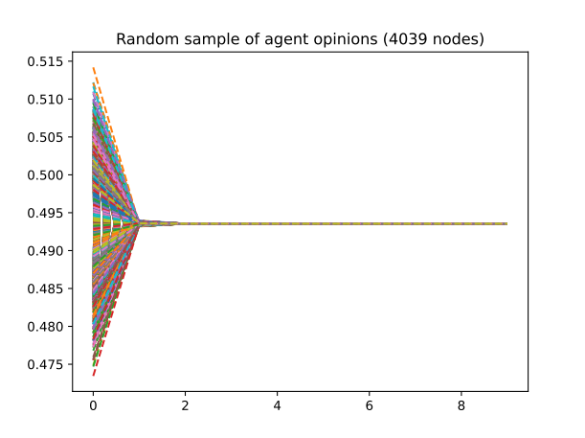
Original Edges
+30% edges
+50% edges
Lattice
Notes:
Seems to be rapid convergence, returning to something equivalent to the original model
Not all self weights immediately converge, could be a new meaningful mechanic

Slide 15
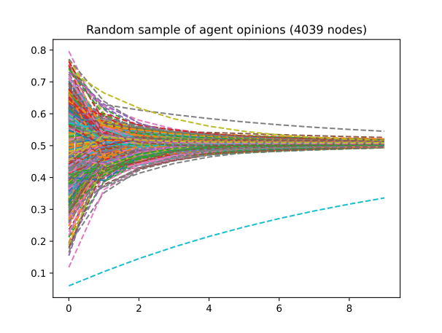
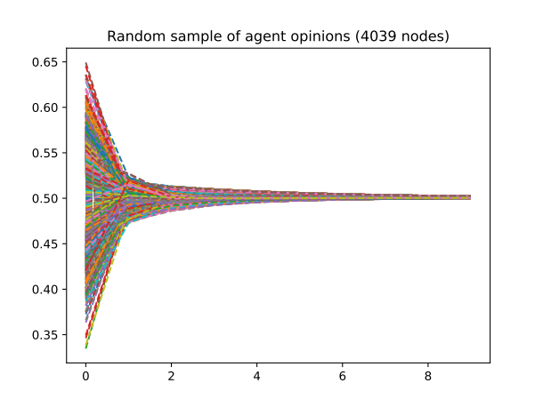
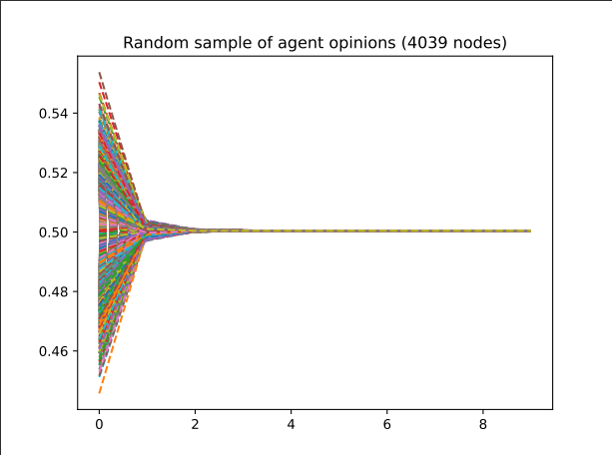
Original Edges
+0.1% edges
+1% edges
+10% edges

Slide 16
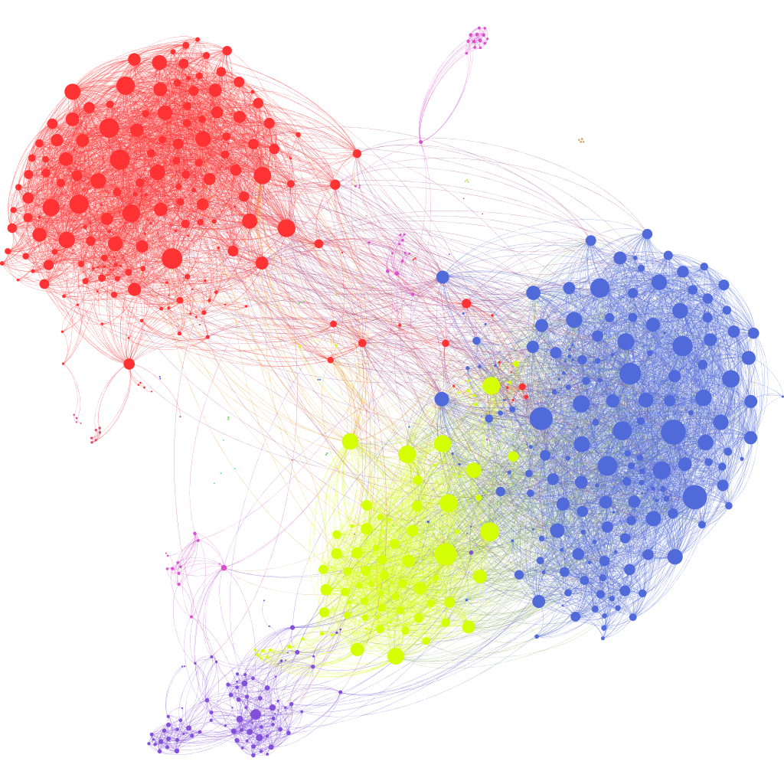
Discussion
Minor changes in outcome but no novel mechanics
Connectivity as the driving factor
Future research
Anonymized Facebook friend graph courtesy of Brendan Griffen
Notes:
Discussion of outcomes:
PFS in particular, model rules appeared to dominate the final outcome
DGF exhibited some novel mechanics, but only under very specific conditions and ultimately led to the same result
Future discussion:
influence networks
weights are no longer random, but informed by interaction frequency/time
more models
more network characteristic studies (complex graph characteristics, triads, stars,
Might ultimately inform us as to whether the network topology of our real social networks could change how we think/are influenced by our friends and acquaintances

Slide 17
Questions & Fin
Notes:
Future discussion:
influence networks
more models
more network characteristic studies

